Slide 1
Image Captioning Service on GKE
PRESENTED BY SIDDHARTH SHAH, LAKSHMI SABARI PRIYA JAINI
02/05/2024

Slide 2
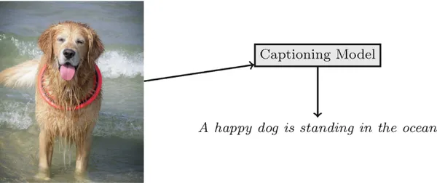
INTRODUCTION
Image captioning is the process of generating textual descriptions/captions for images automatically.
It combines computer vision and natural language processing techniques.
Goal: To build and end to end service the enables machines to comprehend and describe the content of images in natural language.
Notes:
This project encompasses the entire pipeline, from training the model to creating a user interface (UI) for easy interaction and deploying the application on Google Kubernetes Engine (GKE).
By deploying on GKE, the service becomes scalable, reliable, and accessible from anywhere, providing a comprehensive solution for image captioning needs.

Slide 3
Use Cases and Applications
Accessibility: Assisting visually impaired individuals by providing descriptions of images.
Content Generation: Automatically generating captions for social media, news articles, and more.
Image Search: Enhancing image search engines with text-based queries.
Assistive Technology: Supporting applications for aiding memory and navigation.

Slide 4
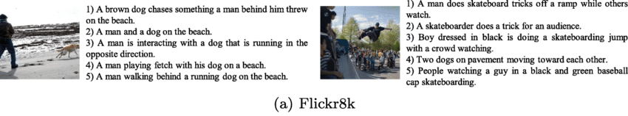
Dataset Description
Dataset: Flickr8k
Contains: 8,000 images
Captions: Each image has five captions, providing diverse descriptions.
Usage: Widely used for research and benchmarking in image captioning tasks.

Slide 5
Overview of the End-to-End Service
Preprocessing:
Data preparation for training.
Training Phase:
Features extracted using deep CNN(Xception Model).
Captions generated by LSTM models.
Inference and UI:
Trained model deployed for real-time inference.
Created a User-friendly Gradio app interface.
Deployed on GKE:
Containerised the application using Docker images
Deployed on Google Kubernetes Engine.

Slide 6
Pre-Processing

Slide 7
Pre-processing
Data Cleaning:
Lowercasing all words, removing punctuation marks.
Eliminating words containing numbers.
Text Tokenization and Serialisation:
Building a vocabulary of unique words.
Tokenizing captions to convert words into integer indices.
Saving tokenizer for later use in model inference.
Data Generator:
Implementing a generator to yield data batches during training.
Generating partial sentence inputs and corresponding next-word outputs

Slide 8
Pre-processing
Sequence Generation:
Why? - Captions are not just a collection of words; they have a logical flow and context. By creating sequences of input-output pairs, we provide the model with context about how words are arranged in a sentence. This helps the model understand the semantic meaning of the words and their relationships within the caption.
Prepared sequences of input-output pairs for model training.
Example: Let's say we have a caption "a cat sitting on a chair". The input-output pairs would be:
Input Sequence: "a"
Output Sequence: "cat"
Input Sequence: "a cat"
Output Sequence: "sitting" and so on
Padded sequences to ensure uniform length.

Slide 9
Training

Slide 10
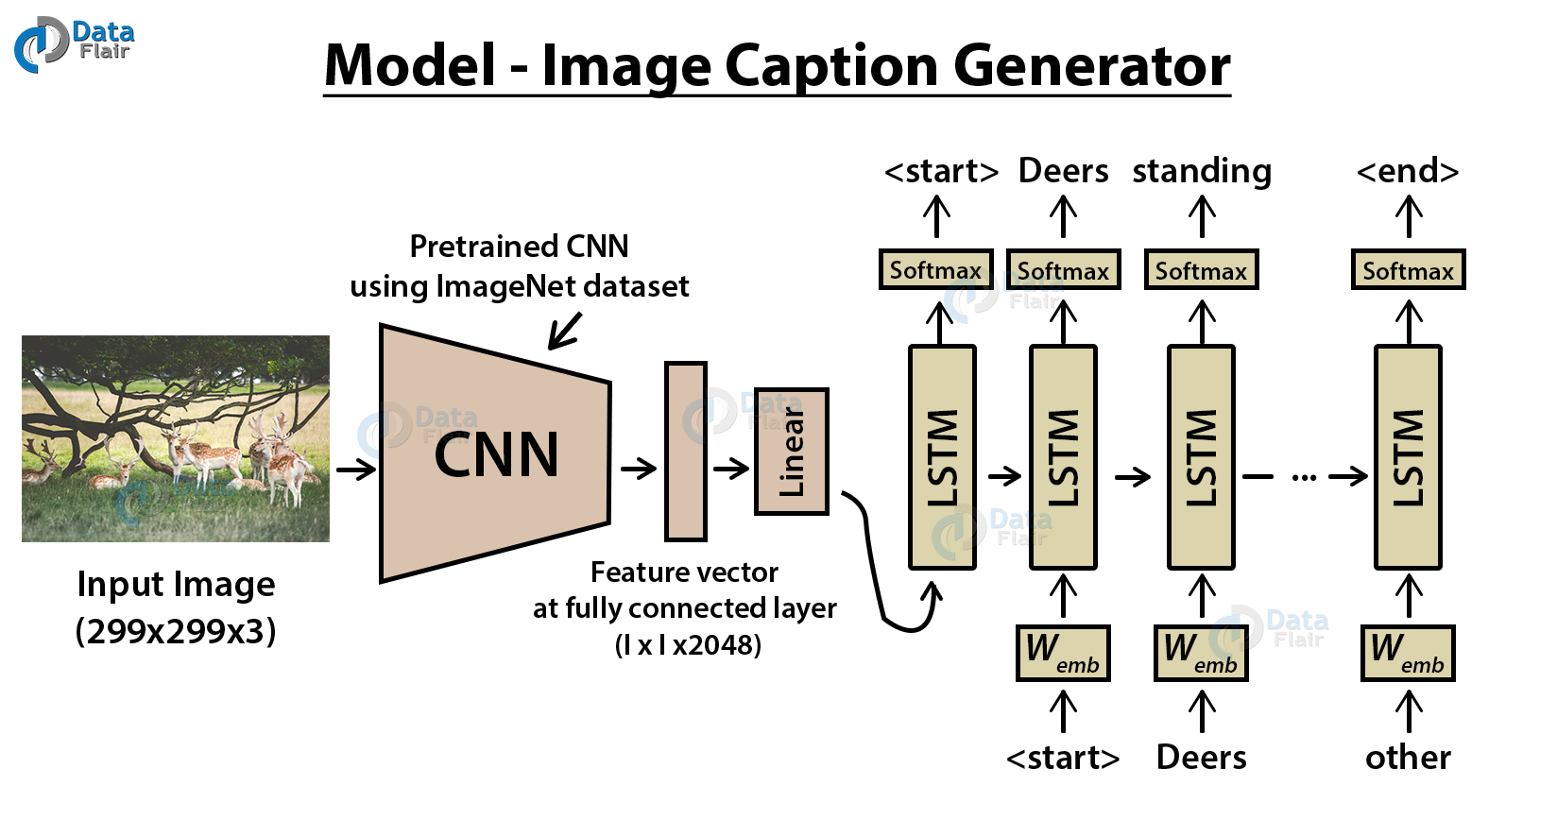
Model Architecture
Encoder-Decoder Architecture
Encoder: Utilizes a pre-trained CNN (Xception) to extract image features.
Decoder: Employs LSTM (Long Short-Term Memory) network to generate captions based on extracted features.
Model Components
Image Feature Extraction:
Extracts high-level features from images using Xception.
Encodes features into a fixed-length vector.
Caption Generation:
Utilizes LSTM to decode image features into meaningful captions.
Learns to predict next word in sequence based on context.

Slide 11
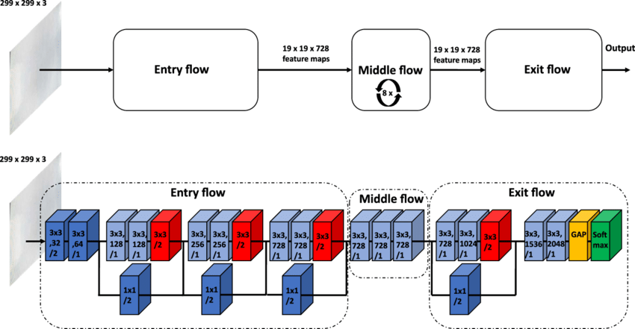
Xception Model
Xception model is a deep convolutional neural network developed by Google.
Based on the principle of depthwise separable convolution which reduces number of parameters and computation complexity
Used the Xception model as the feature extractor.
Transformed input images into a rich set of features, capturing the essence of the visual content without retaining the original image size or complexity.

Slide 12
LSTM Network
LSTM networks are a type of recurrent neural network (RNN) specifically designed to handle sequence prediction problems
Sequentially processed the input features to construct meaningful captions one word at a time.
The input sequences (partial sentences) and the corresponding feature vectors (extracted image features from Xception) were fed into the LSTM model as input.
The model learned to predict the next word in the sequence based on the input features and the context provided by the partial sentence.
Continuously refined its predictions by feeding back the previously predicted words as part of the input for generating subsequent words, enhancing the accuracy of the captions.

Slide 13
Training Process
Training Environment: Utilized Google Colab's T4 GPU for efficient training.
Dataset: Trained using the Flickr8k dataset, ideal for Image Captioning
Batch Processing: Images and captions are fed in batches, optimizing GPU memory usage.
Epochs: Trained for 30 epochs.
Optimizer: Adam optimizer for gradient descent.
Loss Function: Categorical cross-entropy.
Techniques like dropout regularization employed to prevent overfitting and Regular monitoring of validation metrics to ensure generalization.
Notes:
Training LSTMs can be challenging due to issues like vanishing gradients, but techniques such as gradient clipping and using advanced optimizers like Adam helped mitigate these problems.

Slide 14
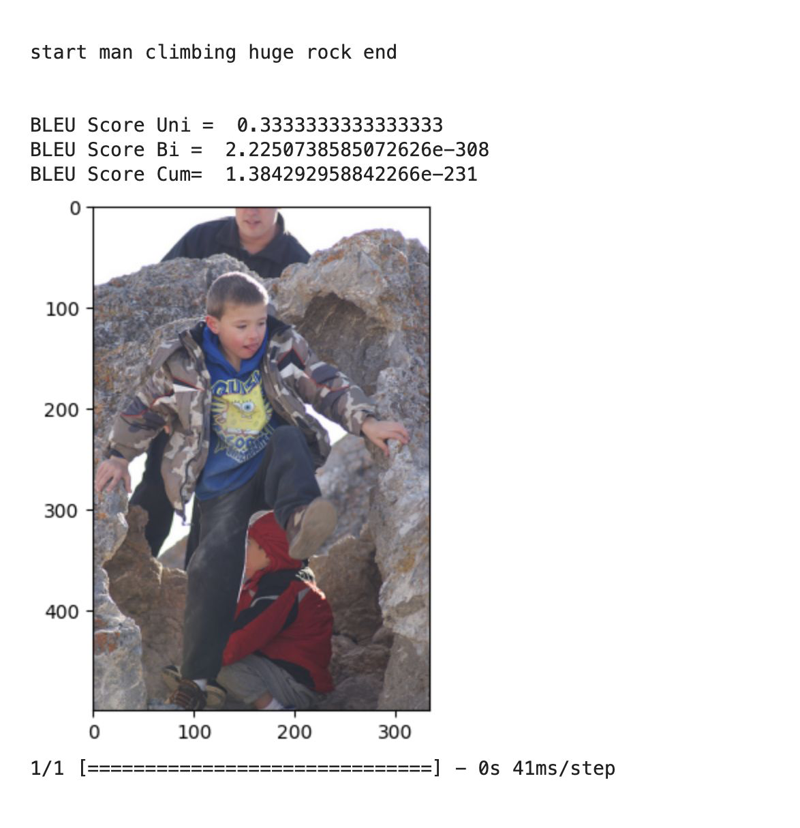
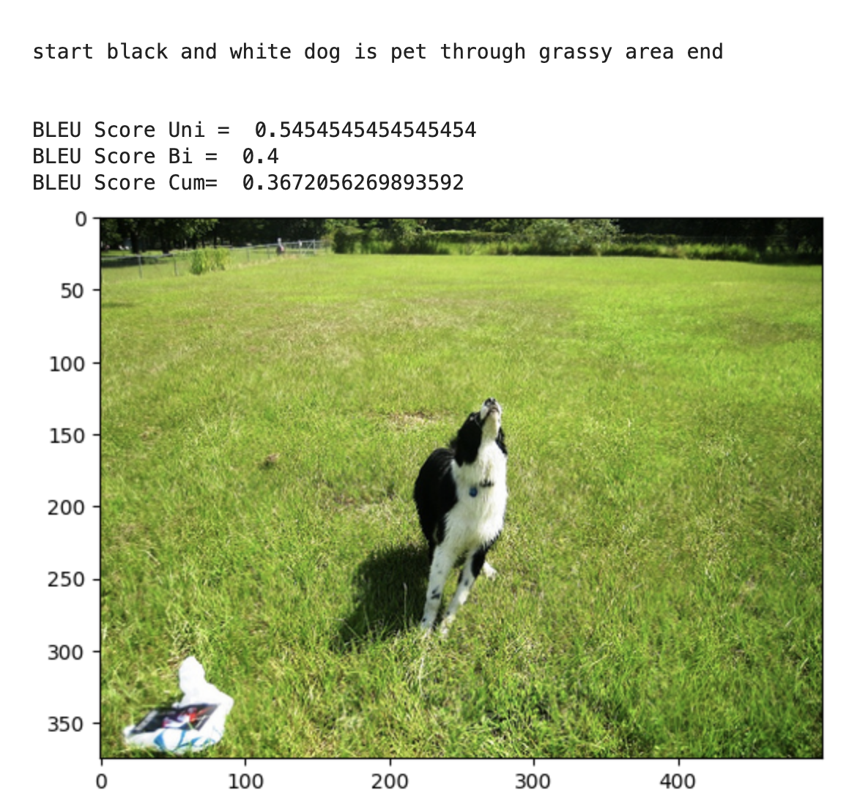
Training Results
Model Convergence:
Throughout the training process, the loss decreases while accuracy increases, indicating effective learning and optimization of the model parameters.
Model converged to optimal performance after 30 epochs with ~60% accuracy
Notes:
BLEU 1 - measures the overlap of unigrams between the generated text and the reference text.
Observations - Very difficult to evaluate the performance of the model as it involved lots of things like context, sequence grammar and so on

Slide 15
Inference and Application

Slide 16
Inference : Overview
Leveraged the trained CNN-LSTM model and tokenizer for real-time inference.
Xception model used to extract meaningful features from the normalized images.
Prediction Loop:
Initiated the caption with the word "start" to begin the sequence generation.
Converted current text to sequences using the tokenizer and padded the sequences.
the LSTM network takes the current sequence of words and the image features as input and generates a probability distribution over the vocabulary.
The word with the highest probability is selected as the next word in the caption.
Continuously predicted the next word using the model until the "end" token was generated or the maximum caption length was reached.

Slide 17
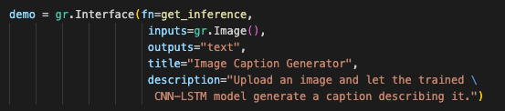
Inference : Gradio Application
Gradio Library: Developed UI using the Gradio library, enabling rapid development of interactive machine learning applications.
Integrates seamlessly with existing Python environments and machine learning models. It supports a variety of frameworks including TensorFlow, PyTorch, and Keras.
Users can upload images directly into the web interface, receive captions, and see how the model interprets different scenes and objects in real-time.

Slide 18
Deployment in GKE

Slide 19
Basics
Docker Containers: They are lightweight, portable, and self-contained environments that encapsulate an application and its dependencies, allowing it to run consistently across different environments.
Kubernetes: It is an open-source container orchestration platform that automates the deployment, scaling, and management of containerized applications.

Slide 20
GKE
Google Kubernetes Engine (GKE) is a managed Kubernetes service, simplifying the deployment, management, and scaling of containerized applications.
Key Features: GKE offers features such as auto-scaling, self-healing, and automated updates, ensuring reliability and efficiency.
Enables seamless deployment of our image captioning service, ensuring high availability and scalability while minimizing operational overhead.

Slide 21
Manifest Files
Pods: The pod YAML file defines a new pod with its configuration such as Docker images, PVs, and other specifications.
Deployments: The deployment YAML file defines how the application should be deployed, including the Docker image, number of replicas, and resource requirements.
Services: The services YAML file specifies how the deployed application should be accessed, including the port mapping and load balancing configuration.
Persistent Volume Claims (PVCs): PVC YAML files define persistent storage requirements for the application, ensuring that data persists across pod restarts or failures.

Slide 22
Managing Volumes
Persistent Volumes (PVs): PVs are storage resources provisioned by the cluster administrator, abstracting the underlying storage details.
Persistent Volume Claims (PVCs): PVCs are requests for storage by the application, allowing pods to access persistent storage resources.
Storage Classes: Multiple storage classes each with a volume binding mode
Immediate: PV is bound as soon as a PVC is created.
WaitForFirstConsumer: PV is only bound when a Pod using the PVC is scheduled.

Slide 23
Scaling and Management
Horizontal Pod Autoscaler (HPA): GKE supports HPA, which automatically adjusts the number of replicas of a deployment or replica set based on observed CPU utilization or other custom metrics.
Cluster Autoscaler: GKE Cluster Autoscaler automatically resizes the Kubernetes node pool when there are insufficient resources available to run all scheduled pods.
Vertical Pod Autoscaler (VPA): GKE also supports VPA, which adjusts the CPU and memory requests for pods to optimize resource usage.
Stackdriver Logging: Stackdriver Logging collects and stores logs from various sources in GKE, including application logs, system logs, and Kubernetes audit logs.

Slide 24
Deployment Workflow

Slide 25
Setting up the Kubernetes Cluster
Standard cluster
More control over the configuration and management of the cluster.
Customize parameters such as node sizes, instance types, node autoscaling policies, node pools, networking, and more.
Autopilot cluster
Managed Kubernetes platform that abstracts away much of the underlying infrastructure complexity.
Designed to automatically provision and manage the underlying infrastructure, including nodes, networking, and security, based on your application's requirements.

Slide 26
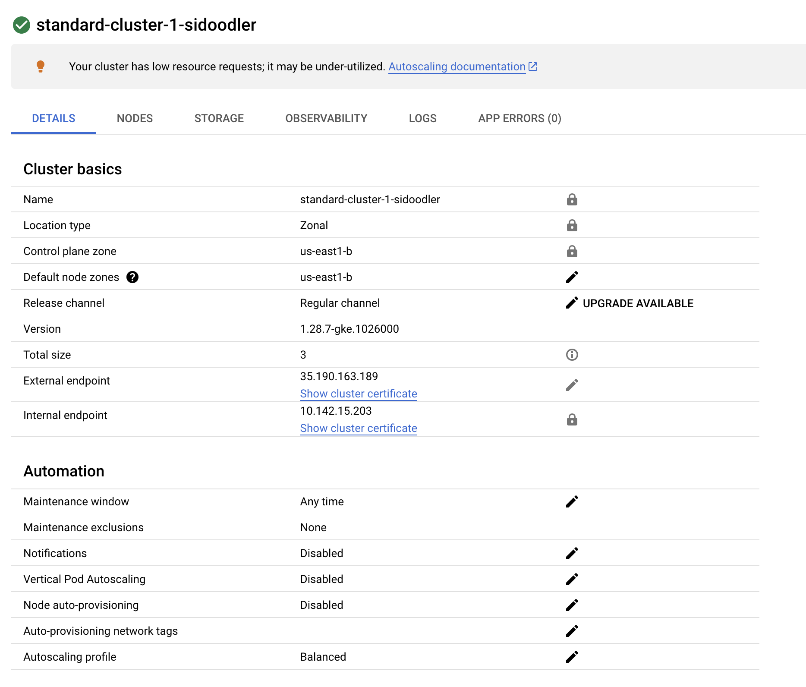
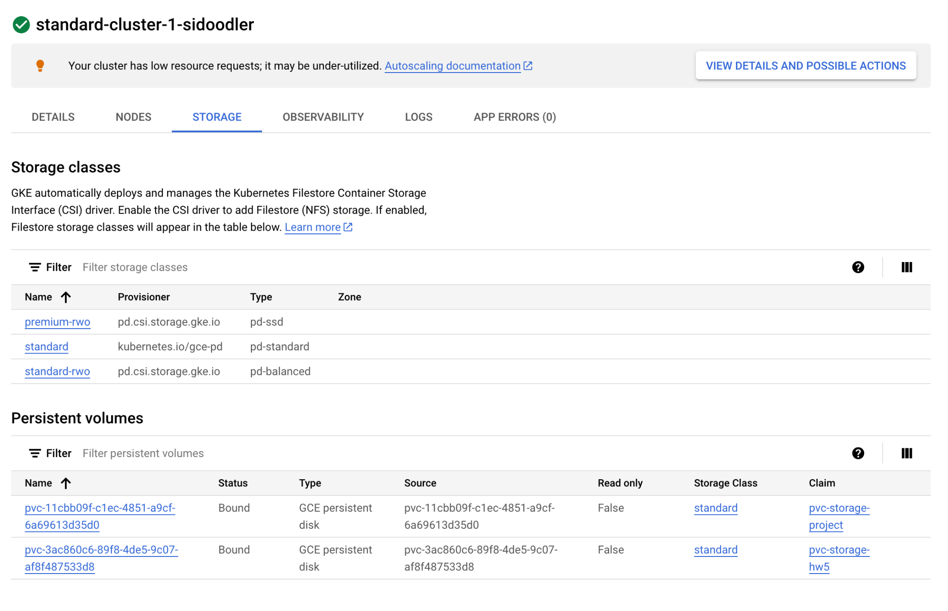
Setting up the Kubernetes Cluster

Slide 27
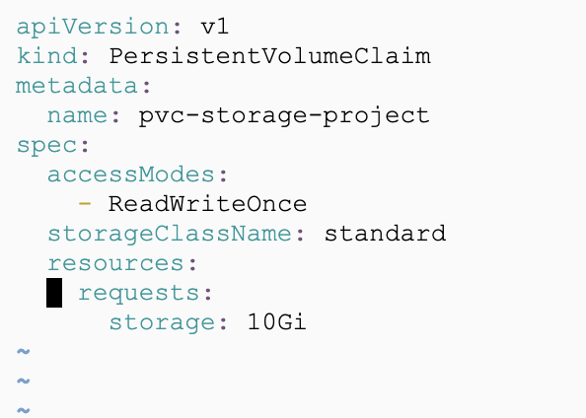
Claiming a PV

Slide 28
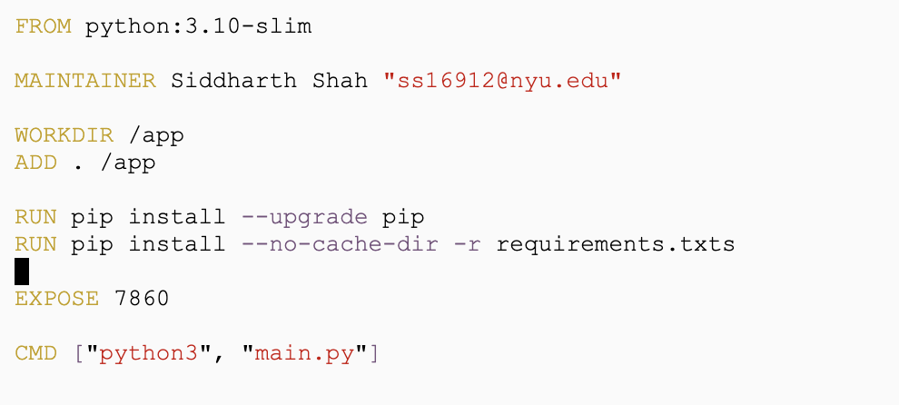
Creating and Managing Docker Image
Container for Inference: Used the below Dockerfile for running inference
Docker Commands: For building, tagging, and pushing the image to DockerHub.
docker build -t inference_image_project . --platform=linux/amd64
docker tag inference_image_project sidoodler/inference_image_project
docker push sidoodler/inference_image_project

Slide 29
Uploading the Trained Model to PV
Google Cloud Storage: Upload your files to a cloud storage service like Google Cloud Storage and then download them to your volume from within a pod.
Either create a new bucket or have access to an existing one
Docker Image: Directly include your model and tokenizer files in your Docker image. This is straightforward but can make the image large and slow to deploy.
Init container: An init container can perform setup tasks like checking for the presence of necessary files before your main application starts.
initContainers:
- name: init-check
image: busybox
command: ['sh', '-c', 'until [ -f /data/model_8k_29.h5 ] && [ -f /data/tokenizer.p ]; do echo "Waiting for model and tokenizer"; sleep 10; done;']
volumeMounts:
- mountPath: "/data"
name: model-per-volume

Slide 30
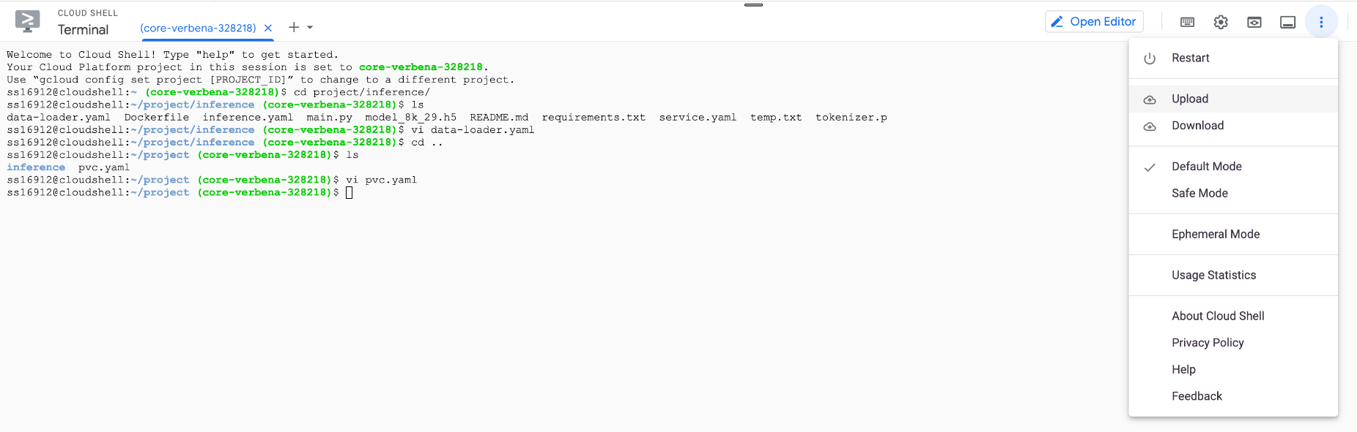
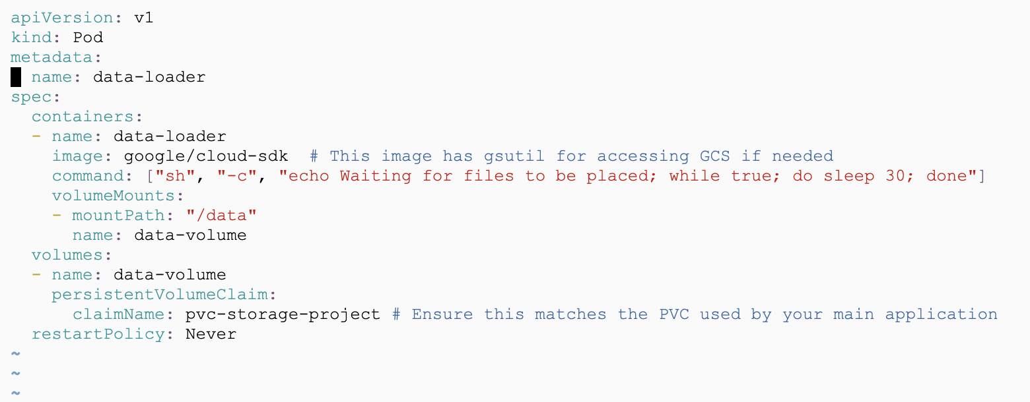
Uploading the Trained Model to PV

Slide 31
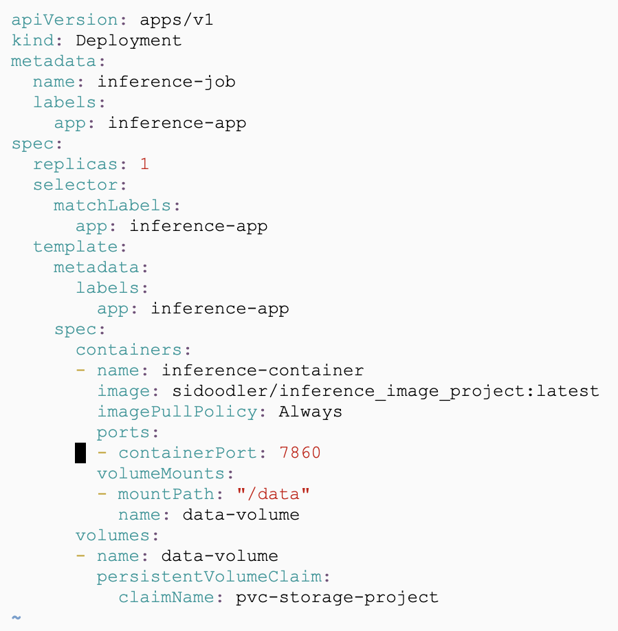
Define and Apply inference.yaml
To apply the deployment YAML -
kubectl apply - inference.yaml
kubectl get pods

Slide 32
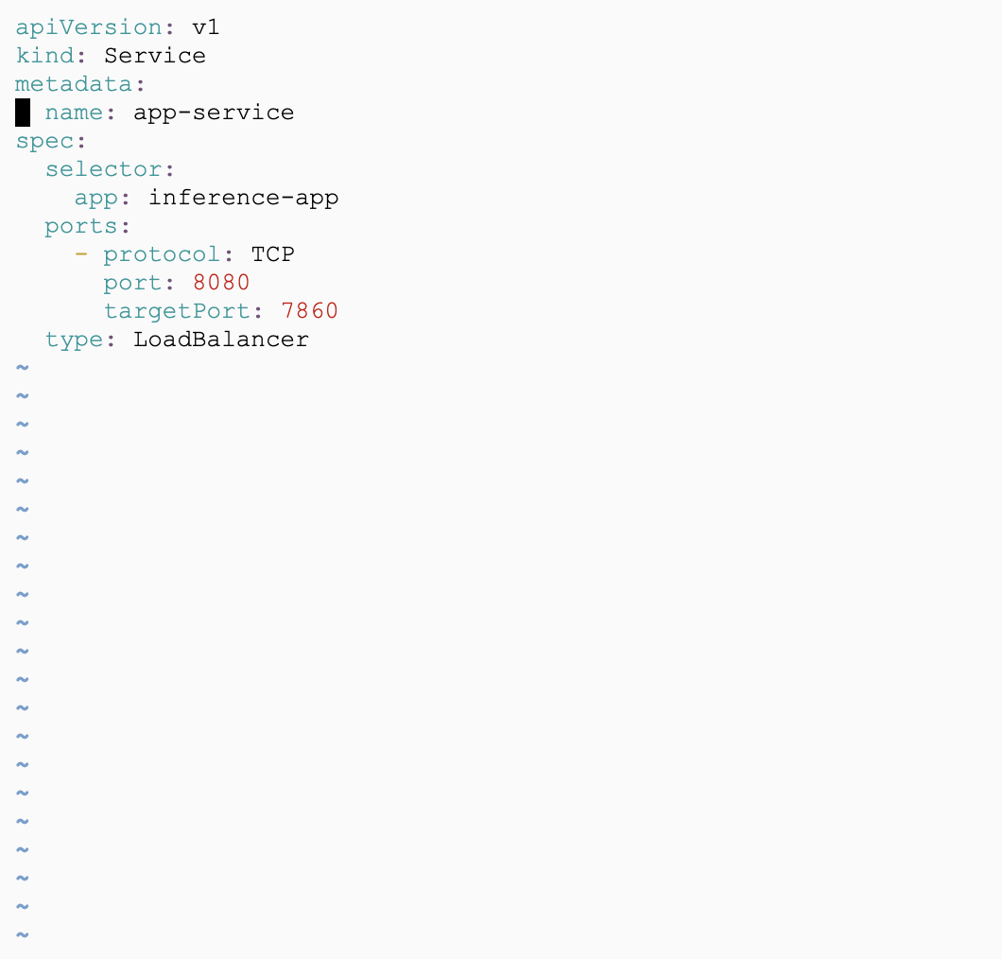
Define and Apply service.yaml
To apply the service YAML -
kubectl apply -f service.yaml
kubectl get services
kubectl port-forward $(kubectl get pod --selector="app=inference-app" --output jsonpath='{.items[0].metadata.name}') 8080:7860

Slide 33
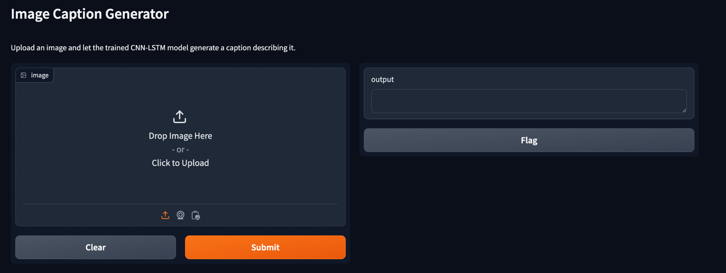
Application

Slide 34
Demo

Slide 35
Conclusion and Future Works
Future Improvement Areas
Accuracy Enhancement: Explore advanced techniques like attention mechanisms and transformer architectures to improve image captioning accuracy.
CI/CD Implementation: Implement CI/CD pipelines to automate testing, building, and deployment processes, leading to faster release cycles and improved code quality.
Extension to video captioning: Extend the application to support video captioning, allowing users to upload videos and generate descriptive captions in real-time.

Slide 36
References
Models: https://data-flair.training/blogs/python-based-project-image-caption-generator-cnn/
Lecture Slides
Kubernetes: https://kubernetes.io/docs/home/
Docker : https://docs.docker.com/get-started/overview/
GKE: https://cloud.google.com/kubernetes-engine?hl=en
Model deployment on GKE : https://mirdan.medium.com/deploy-scalable-web-application-to-google-kubernetes-engine-gke-ff370ded47f4
Gradio : https://www.gradio.app/guides/quickstart

Slide 37
Thank You

